Slide 1
Artificial Intelligence CS361
Team Members:
Islam Abd-Elhady
Hussein Abd-Elkader
Ramez Nasser
Ahmed Alaa
Enas Ragab

Slide 2
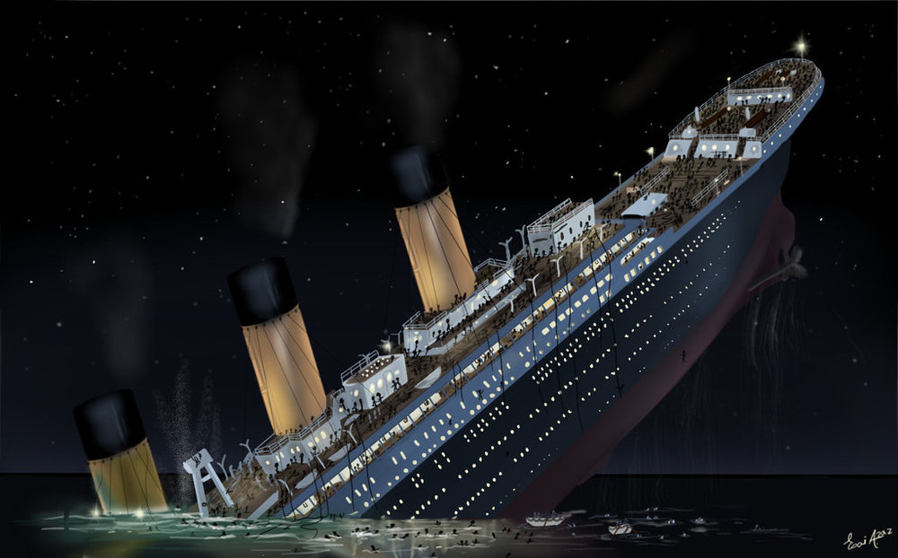

Titanic Survivor Prediction Using Random Forest

Slide 3
Introduction
The sinking of the RMS Titanic is one of the most infamous shipwrecks in history.
In this challenge, we are trying to complete the analysis of what sorts of people were likely to survive.
In particular, we apply the tools of machine learning to predict which passengers survived the tragedy.

Slide 4
Goals And Objective
The purpose of this project is to document the process I went through to create my predictions for Titanic Survivor Prediction.
The objective of this project was to build a classification model that could successfully determine whether a Titanic passenger lived or died.

Slide 5
Random Forest
Random forest is a commonly-used machine learning algorithm trademarked by Leo Breiman and Adele Cutler, which combines the output of multiple decision trees to reach a single result.
Its ease of use and flexibility have fueled its adoption, as it handles both classification and regression problems.

Slide 6
Implementation
Importing the necessary libraries.
Importing the dataset.
Cleaning and analyzing the dataset.
Using random forest for making prediction.

Slide 7
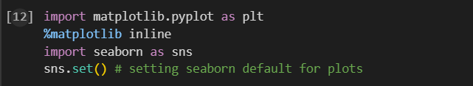
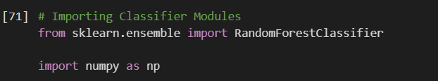
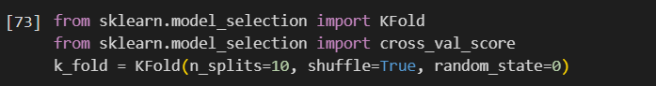
Importing The Necessary Libraries

Slide 8
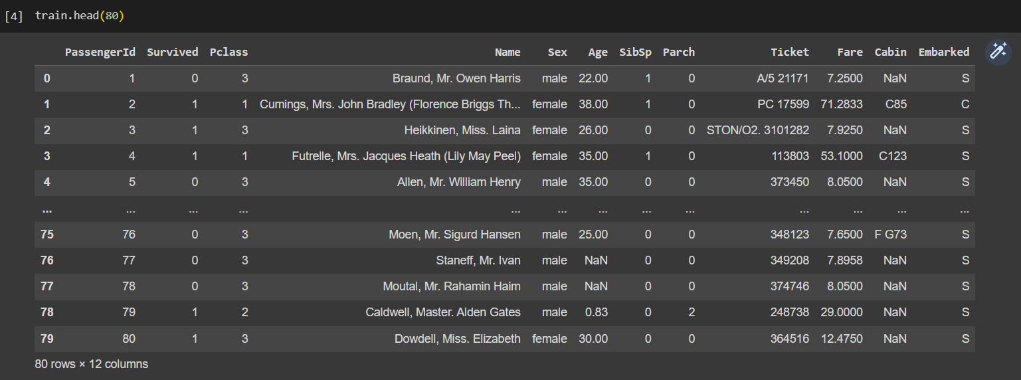
Read And Explore The Data

Slide 9
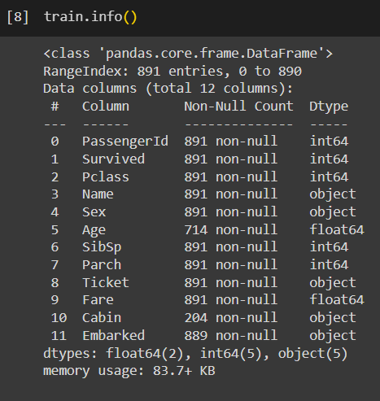

Slide 10
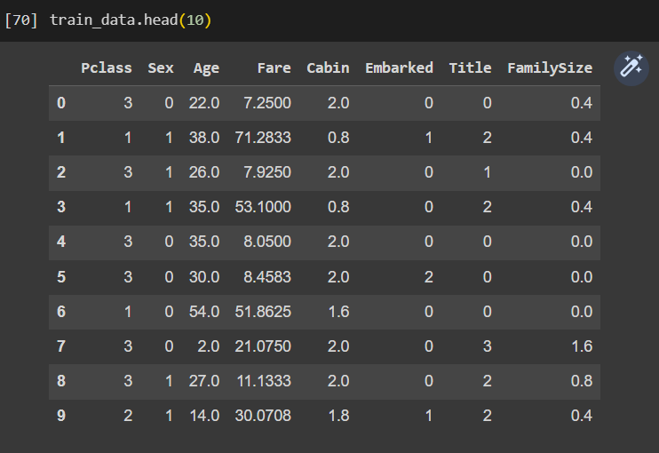
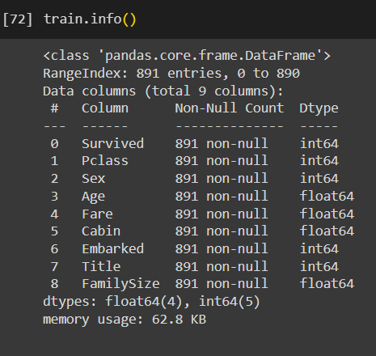
Cleaning The Data

Slide 11
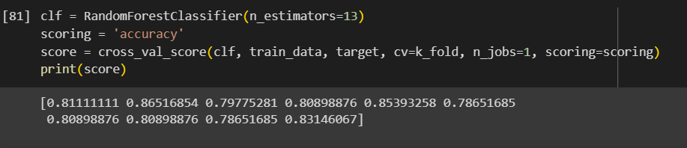
Building The Model

Slide 12
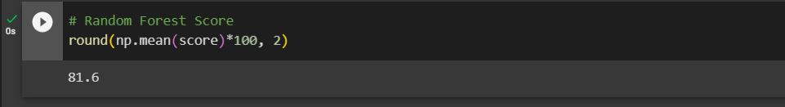
Making Predictions And Calculating Accuracy:
The best accuracy rate: 81.6

Slide 13
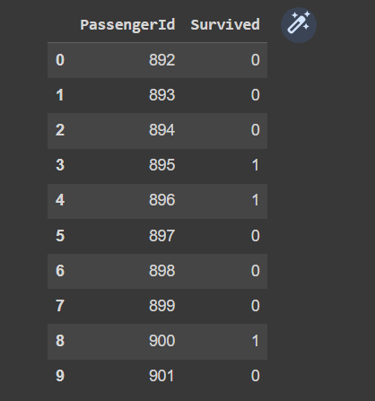
Results

Slide 14
Thanks 🥰

